Slide 1

Amazon Sales Data Analysis Report.

Slide 2
Objective:
To create a report on Sales Trend Year-wise, Month-wise to understand the factors directly affecting the sales and gain competitive advantage acquiring good chunk of market share.

Slide 3
Data Descriptions :
The dataset consists of following columns:
Discount Amount: Discount on every ordered item.
Date: Ordered Date .
Item: Name of the item ordered.
List Price: The price at which the item is listed.
Sales Amount: Total amount of sales for particular item.
Sales Cost Amount: Amount spent for conversion of Sale.
Sales Margin Amount: Margin amount on each item sold.
Sales Quantity: Total number of items sold.
Sales Representative: Representative under whom sale is completed.

Slide 4





Tools Used
● Programming Language: Python
● Python Libraries: NumPy, Pandas
● Business Intelligence Tools: Excel, Tableau

Slide 5
Data Import and Data Cleaning.
Import the given excel file in Jupter Notebook for cleaning.
Data Cleaning is a important as the dataset has impurities such as missing values , null values and incorrect data types.
We used Pandas library in Python to remove missing values and somewhere used fillna_mean() to fill null values make and dataset was ready for creating visual reports.

Slide 6
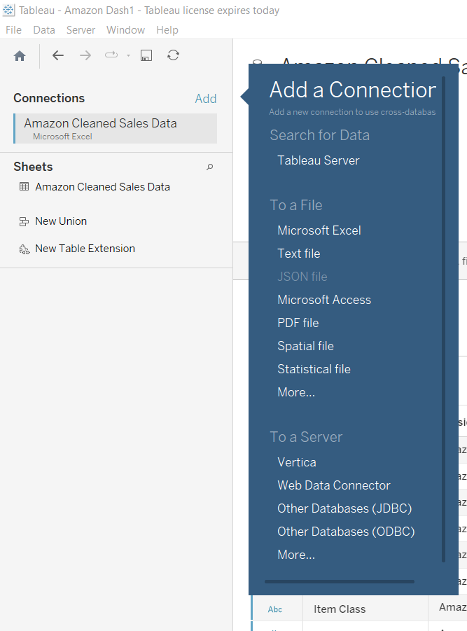
Importing Data set into Tableau.
In Tableau, we have options to connect to our dataset via various options such as SQL Server, excel or CSV files etc.
We have our clean data in CSV file. We will import it in tableau with import data option and start working with it.
After importing data we can clearly access it and if we want to change any thing we can using querys.

Slide 7
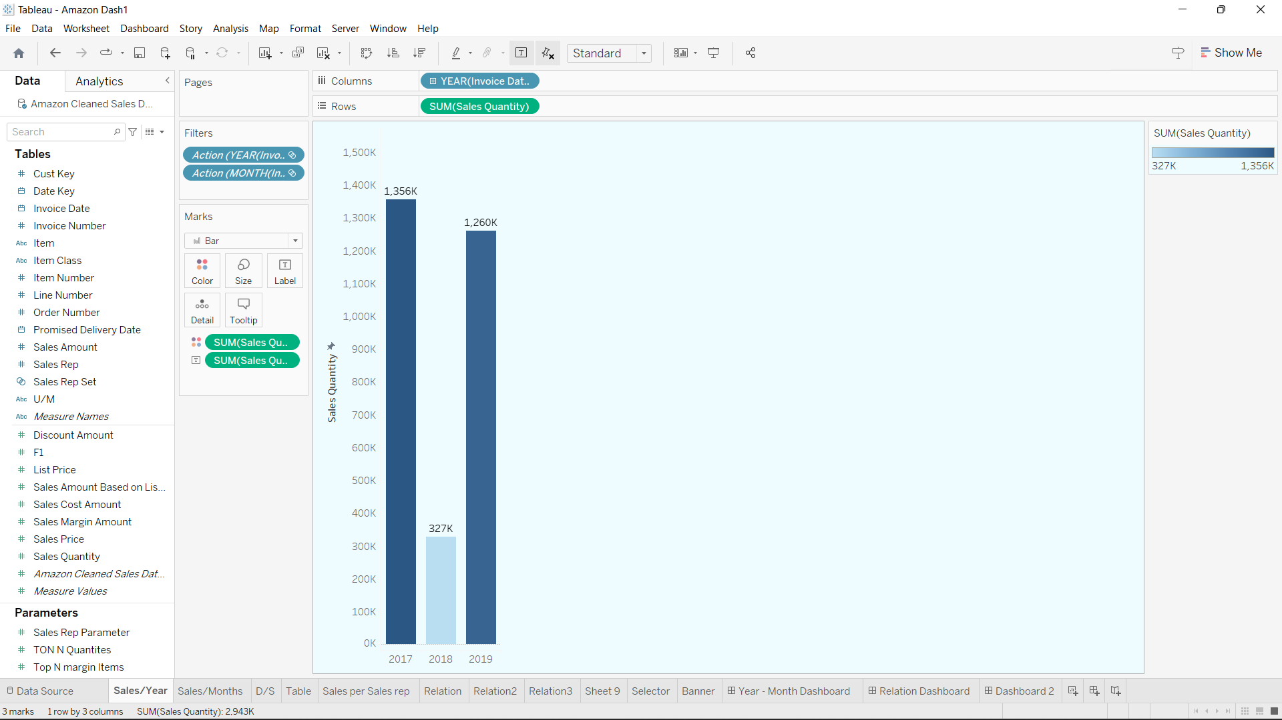
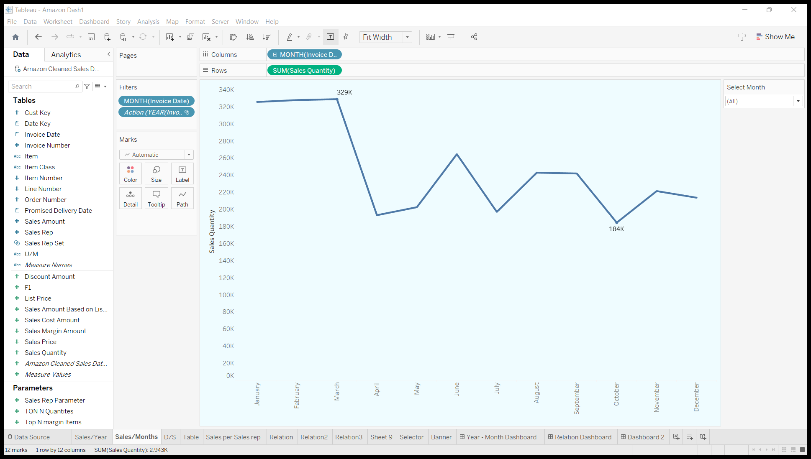
Creating Visuals Using Tableau.
A report is created in Tableau with various charts depicting Sales insights for particular year, month and so on.
We created Slicers, Tables, Sales Trend for Year and Month, Table for top ordered item, top performing sales representatives and relationship between different variables.

Slide 8
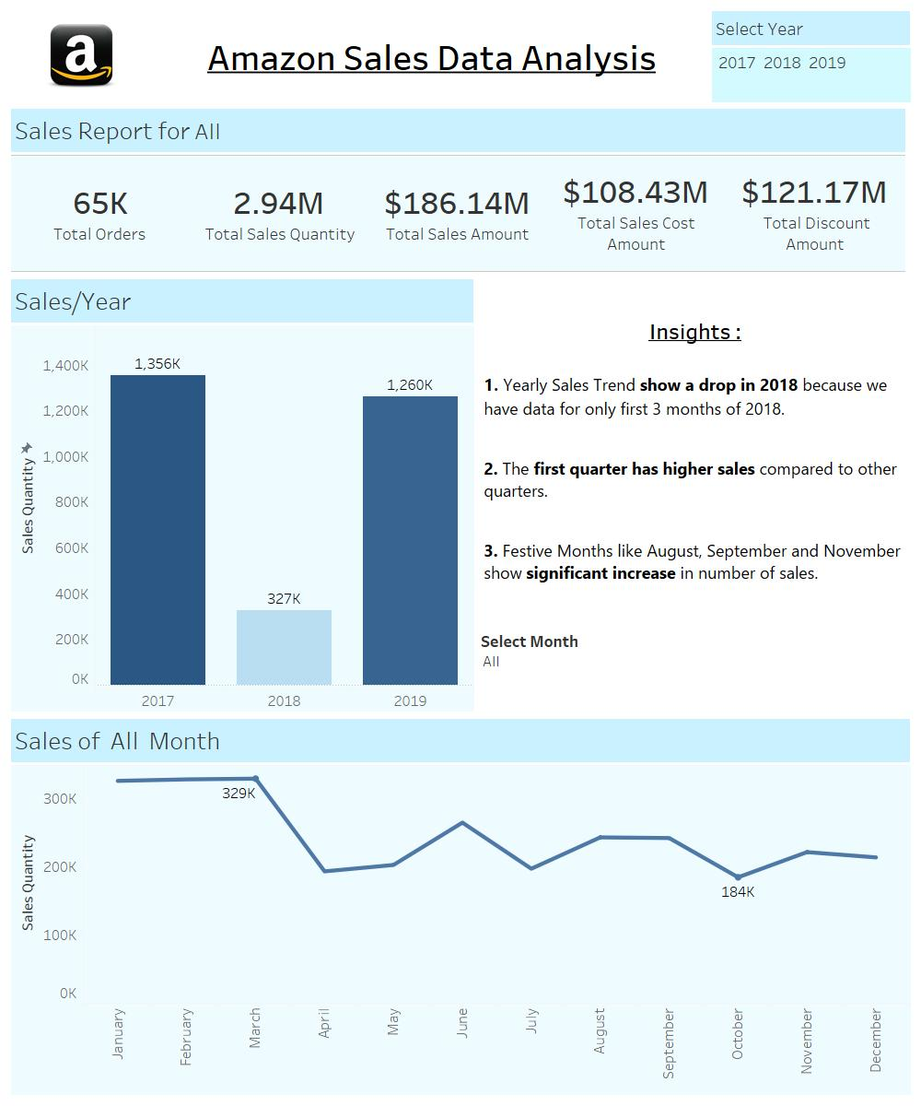
Sales Dashboard per Years and Months.
Created the dashboard of sales of Quantity Years wise and Months.
Added slicers as (Select Years) into the dashboard with different years and months.
Adding Summary report of (Total orders, Total Sales Quantity, Total Sales Amount, Total Sales Cost Amount, Total Discount Amount ).
<------------------Insights --------------------------->
Yearly Sales Trend show a drop in 2018 because we have data for only first 3 months of 2018.
The first quarter has higher sales compared to other quarters.
Festive Months like August, September and November show significant increase in number of sales.

Slide 9
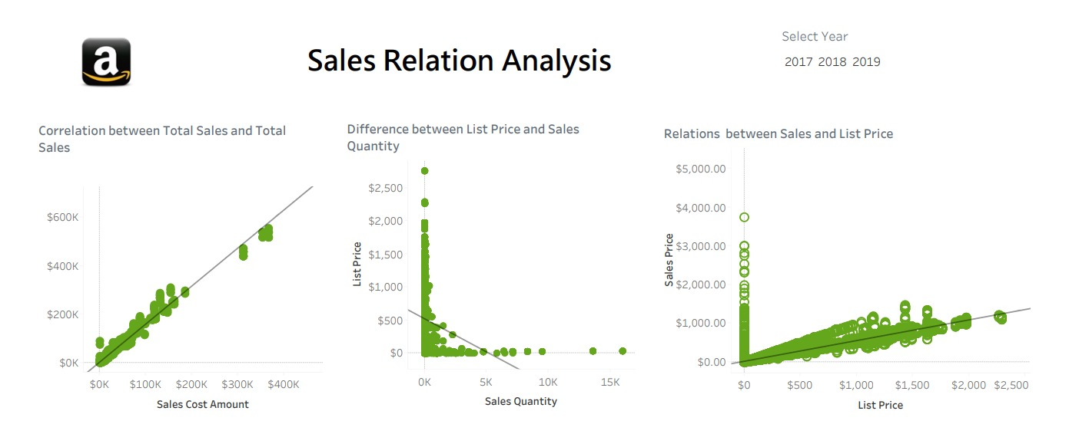
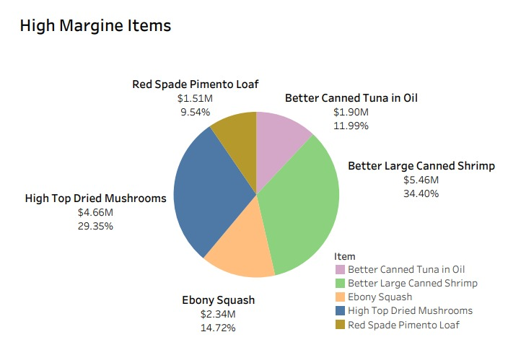
Sales Dashboard As Per Sales Relation Analysis
Creating the Sales relation and correlation Graphs between Total Sales, Total Discount, List Price, Sales Quality.
Visualizing pie chat for top five High Margin items.
<------------------------------------------------------------------->
INSIGHTS
--------We can clearly Understand the trend --------
1. As the Cost of Sales increases the Sales Amount also increases. More Spend is leading to More Sales.
2. There is no correlation between Sales Quantity and List Price. Low Price is not leading to higher sales
3. There is almost a straight line between List Price and Sales Price. Barring few points, the discount amount is marginal for most of the items.
4. High Margin Items like 'Better Large Canned Shrimp' and 'High Top Dried Mushrooms' generate more revenue with high margin and hence more profit.

Slide 10
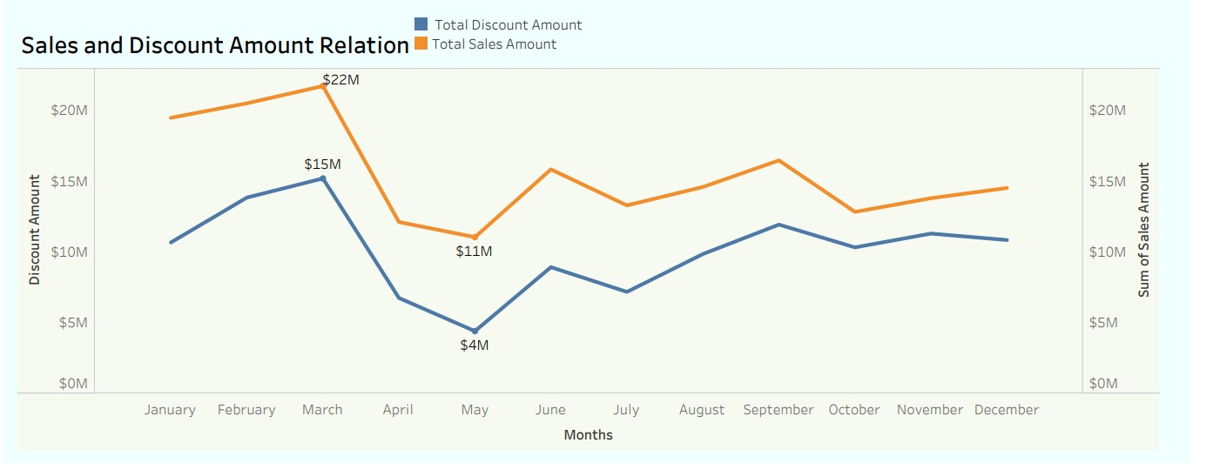
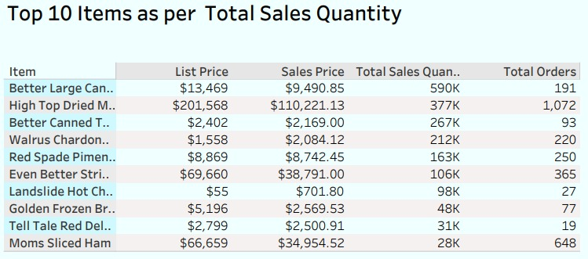
Dashboard Third Of Sales Analysis.
Increase in the discount amount has led to increase in the Sales amount as well. Typical time period of Amazon Shopping Sales is around June, August, November and June.
The Shopping Sale boosts sales amount.
'High Top Dried Mushrooms' has the highest number of orders because it was listed at a huge discount price.

Slide 11
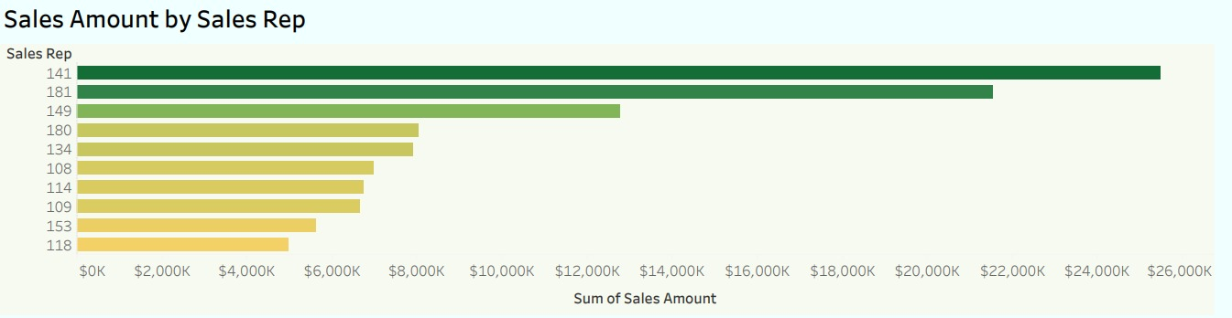
Top 10 Sales Representative Analysis.
Sales Representative Ids '141' and '181' have the upper hand in achieving highest number of sales amount.

Slide 12
---------------------------
THANKYOU
---------------------------

